Slide 1
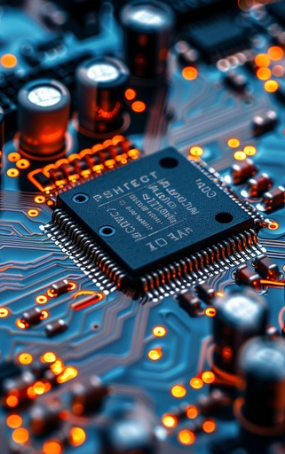
High-Pass Filters
Fənn: Texniki xarici dil
Müəllim: Səfərov Rza
Tələbə:Həsən Hümbətov 623.21

Slide 2
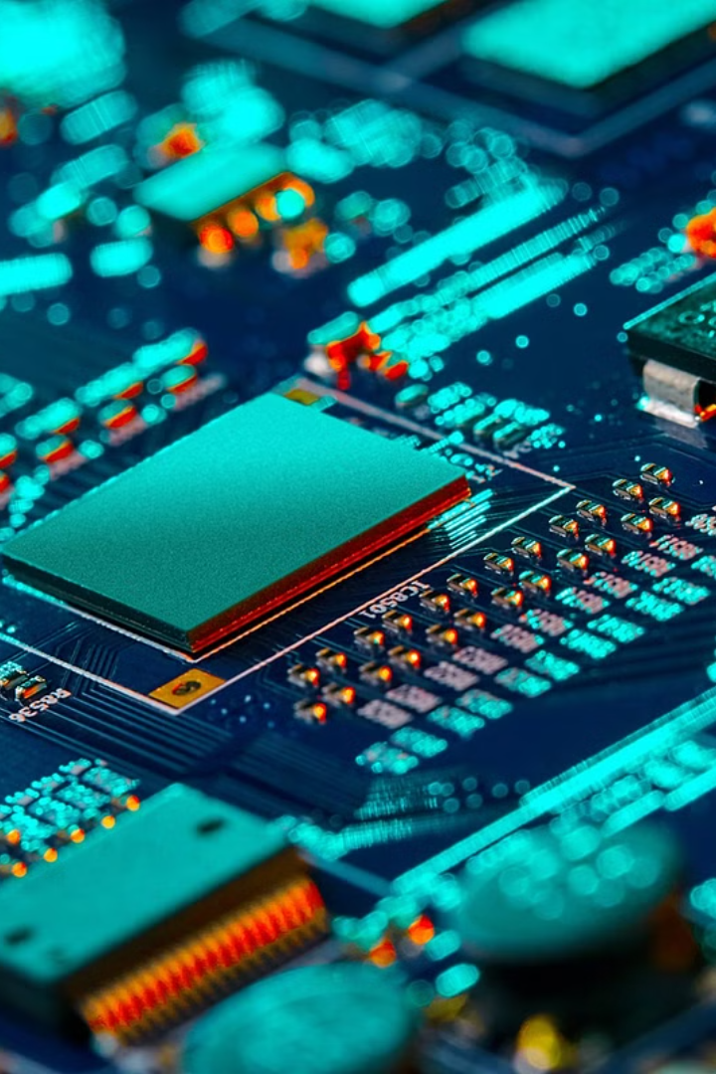
High-Pass Filters
High-pass filters are essential components in electronic circuits. They allow high-frequency signals to pass through while attenuating low-frequency signals. These filters are used in various applications, including audio systems, communication networks, and medical devices.

Slide 3
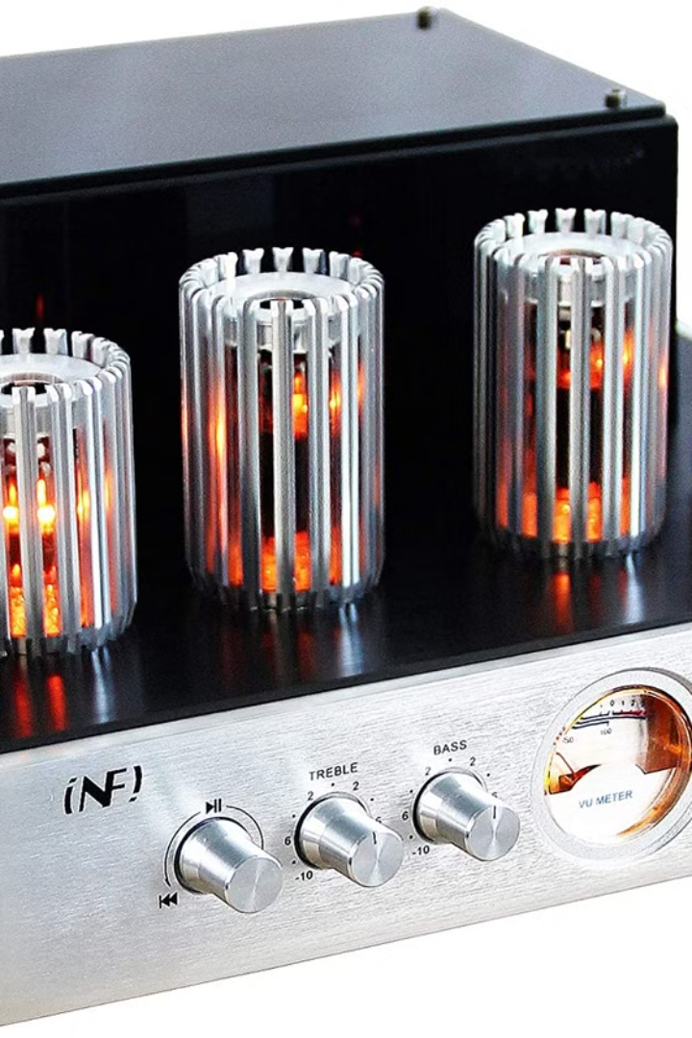
Introduction to Filters in Electronic Circuits
Electronic circuits use filters to manipulate signal frequencies. Filters can be used to remove unwanted frequencies, enhance desired frequencies, or shape a signal's frequency response. Filters are used in various electronic applications.
1
Low-Pass Filters
2
High-Pass Filters
Attenuate high-frequency signals while allowing low-frequency signals to pass through.
Attenuate low-frequency signals while allowing high-frequency signals to pass through.
3
Band-Pass Filters
4
Band-Stop Filters
Allow a specific range of frequencies to pass through while attenuating frequencies outside that range.
Attenuate a specific range of frequencies while allowing frequencies outside that range to pass through.

Slide 4
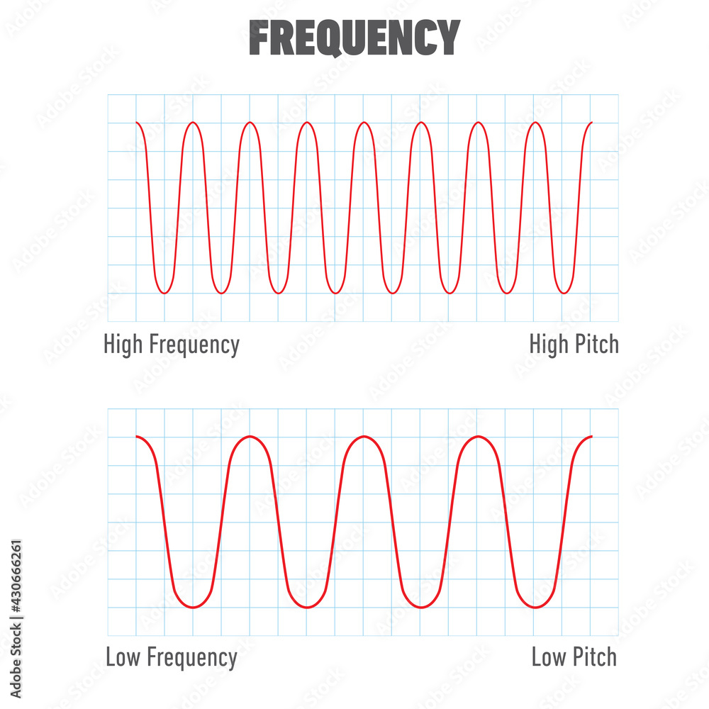

Understanding Frequency and Frequency Bands
Frequency refers to the rate at which a signal oscillates. Signals can be categorized into frequency bands based on their frequency range. These bands are used in various applications, including radio communication, audio engineering, and signal processing.
1
Audio Frequencies
The range of frequencies humans can hear, typically 20 Hz to 20 kHz. It is divided into sub-bands, including bass, midrange, and treble.
2
Radio Frequencies
Used for wireless communication, including AM and FM radio, as well as cellular and satellite communication. These frequencies range from kHz to GHz.
3
Optical Frequencies
Used in optical communication and technology, including fiber optic cables, lasers, and light detectors. These frequencies are in the THz range.

Slide 5

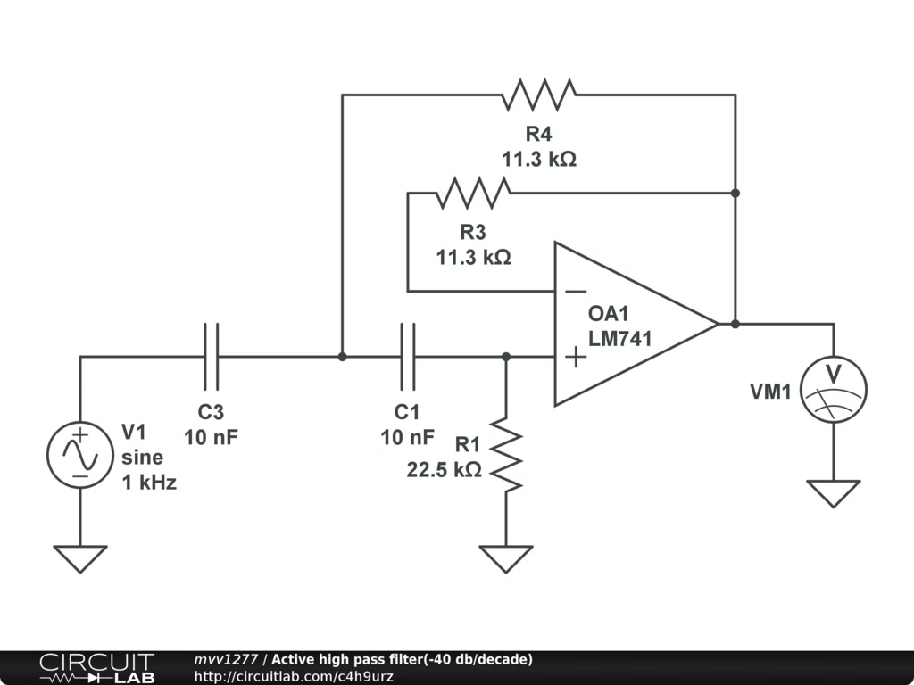
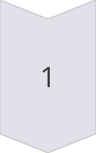
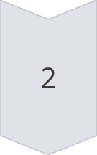
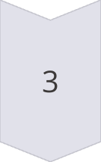
What is a High-Pass Filter?
A high-pass filter is an electronic circuit that allows high-frequency signals to pass through while attenuating low-frequency signals. The cutoff frequency is the frequency at which the filter starts to attenuate signals.
Signal Input
The signal to be filtered is applied to the filter's input.
Filter Circuit
The filter circuit contains components that selectively pass or attenuate signals based on their frequency.
Signal Output
The filtered signal is available at the filter's output.

Slide 6
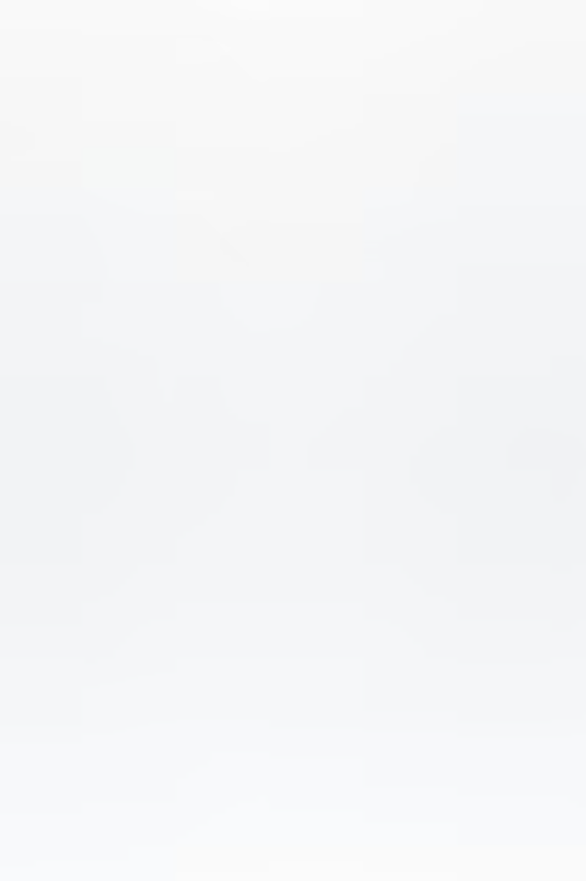
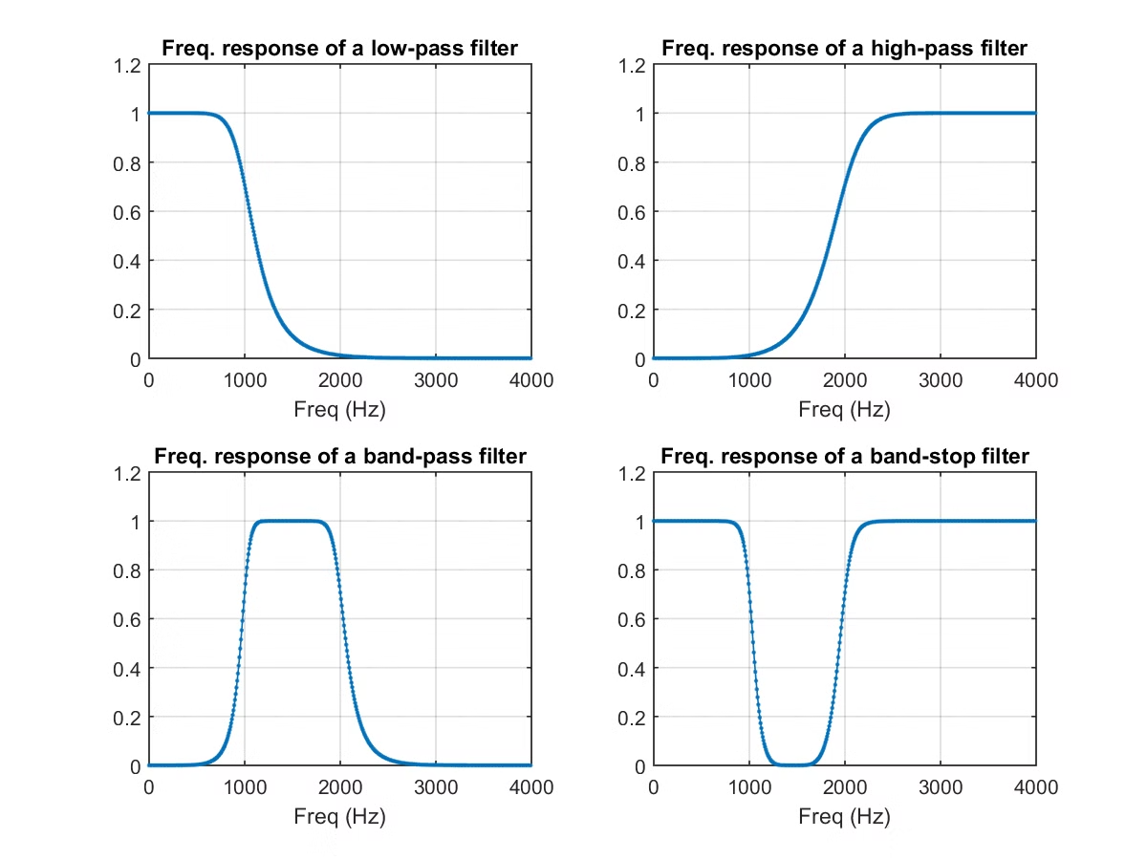
Characteristics of High-Pass Filters
High-pass filters are characterized by their cutoff frequency, roll-off rate, and passband and stopband characteristics.
Cutoff Frequency
The frequency at which the filter starts to attenuate signals.
Roll-Off Rate
The rate at which the filter attenuates signals beyond the cutoff frequency.
Passband
The range of frequencies that the filter allows to pass through with minimal attenuation.
Stopband
The range of frequencies that the filter significantly attenuates.

Slide 7

Design Considerations for High-Pass Filters
Designing a high-pass filter involves selecting appropriate components, determining the cutoff frequency, and considering the required roll-off rate.
Cutoff Frequency
Roll-Off Rate
The cutoff frequency is a critical parameter that determines the filter's frequency response.
The roll-off rate determines how quickly the filter attenuates signals beyond the cutoff frequency.
Component Selection
Choosing appropriate components, such as resistors and capacitors, is crucial for achieving the desired filter characteristics.

Slide 8
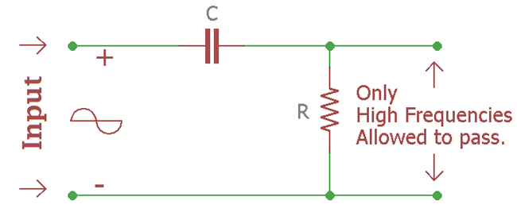
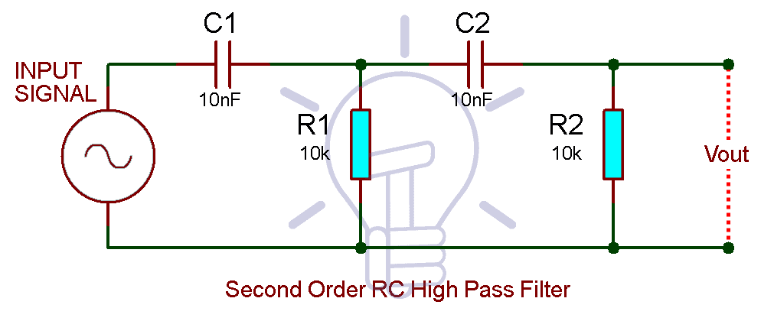
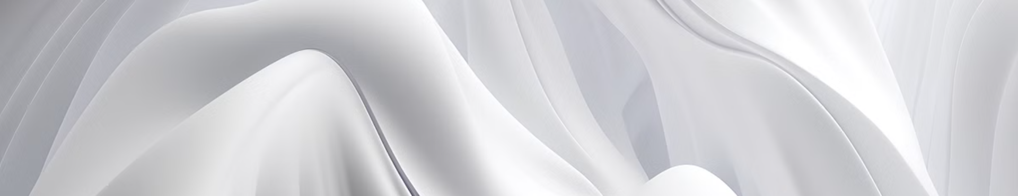
Passive High-Pass Filter Circuits
Passive high-pass filters are constructed using passive components, such as resistors and capacitors. These filters are simple to implement but may have limitations in terms of performance and flexibility.
RC Filter
RL Filter
A common passive high-pass filter that uses a resistor and a capacitor in series.
Uses a resistor and an inductor in series. It offers higher impedance at low frequencies compared to RC filters.

Slide 9
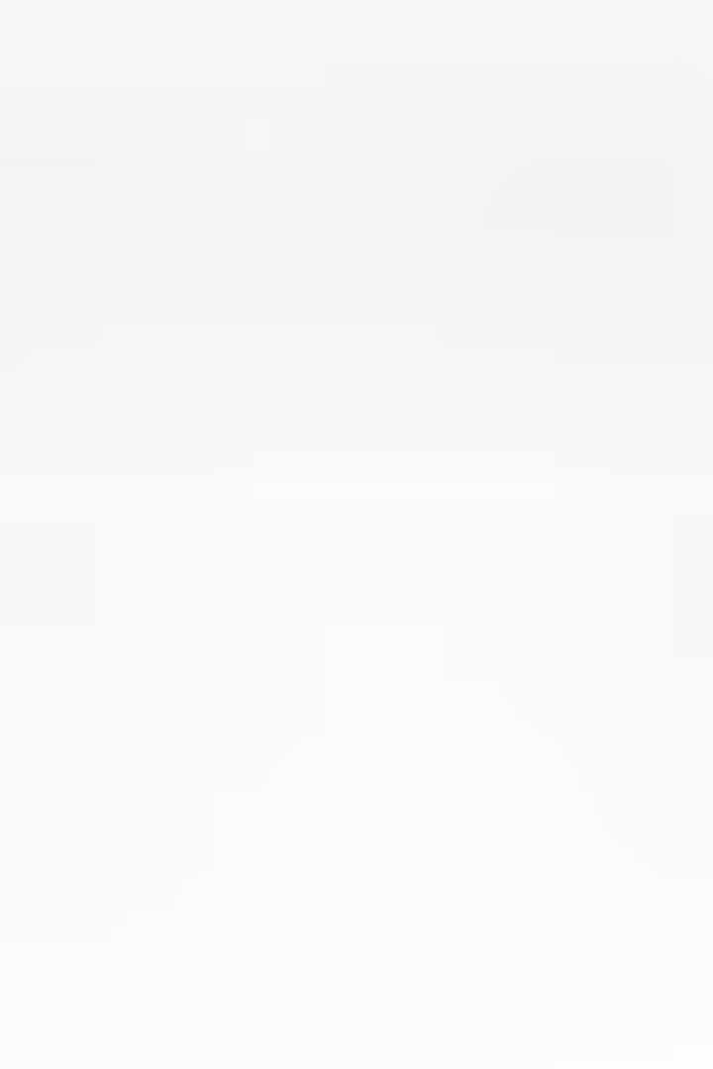
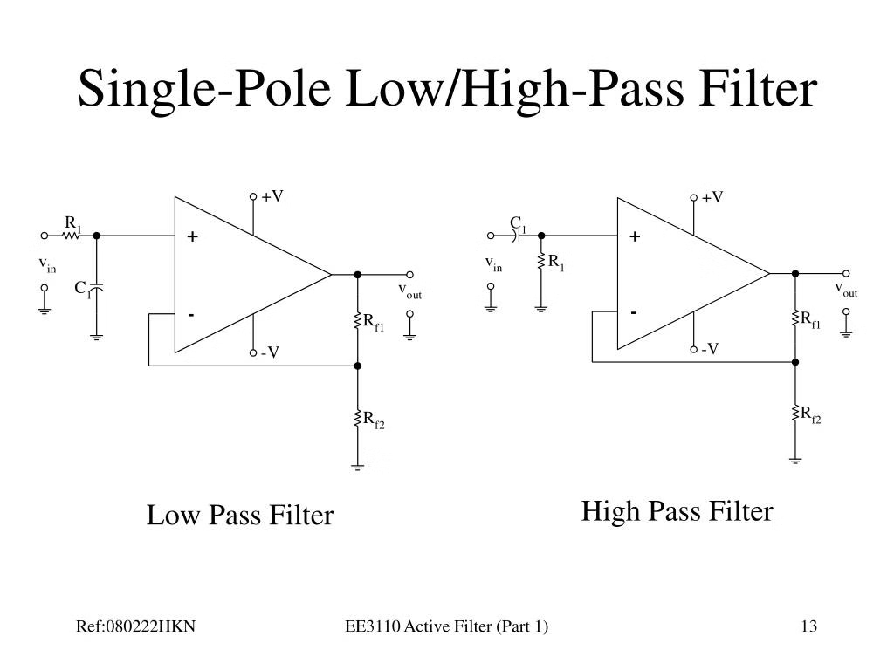



Active High-Pass Filter Circuits
Active high-pass filters use active components, such as operational amplifiers (op-amps), to enhance performance and flexibility. These filters can achieve steeper roll-off rates and lower cutoff frequencies compared to passive filters.
Gain Control
Active filters can amplify the signal, which can improve the signal-to-noise ratio.
Improved Performance
Active filters offer better roll-off characteristics and lower cutoff frequencies.
Flexibility
Active filters can be easily customized to meet specific requirements.

Slide 10
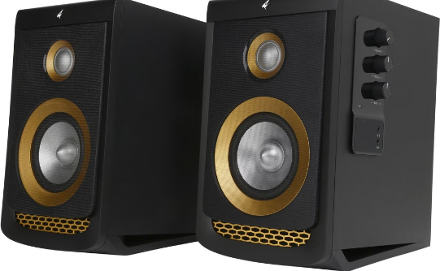
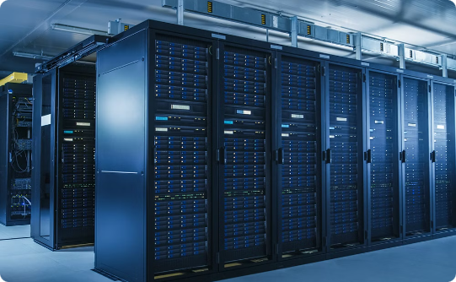
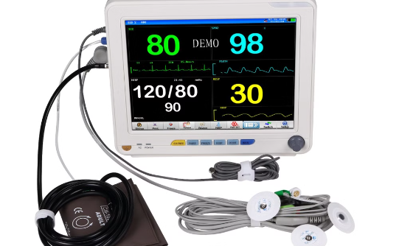
Applications of High-Pass Filters
High-pass filters are widely used in various electronic applications, from audio systems to communication networks.
Audio Systems
Communication Networks
Medical Devices
Used to separate high-frequency signals for tweeters and low-frequency signals for woofers.
Used to remove low-frequency noise and interference from signals.
Used to filter out unwanted noise and interference from medical signals, such as ECG and EEG.

Slide 11
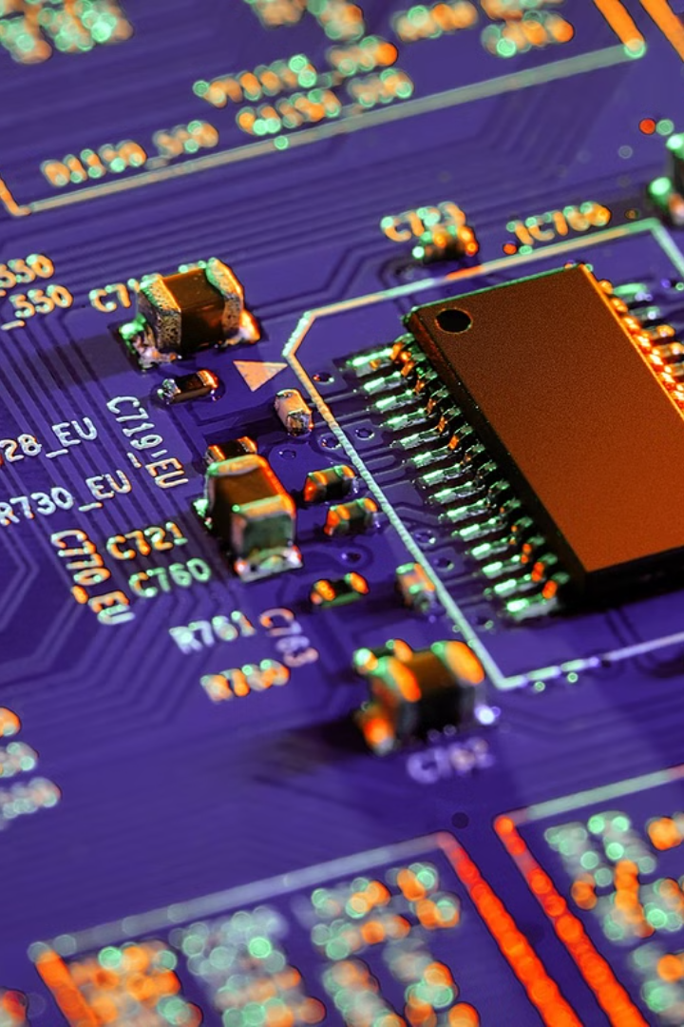
Conclusion and Key Takeaways
High-pass filters are essential components in electronic circuits that allow high-frequency signals to pass through while attenuating low-frequency signals.
1
Frequency Filtering
2
Cutoff Frequency
High-pass filters selectively allow high-frequency signals to pass through while attenuating low-frequency signals.
The cutoff frequency determines the point at which the filter starts attenuating signals.
3
Applications
High-pass filters are widely used in audio systems, communication networks, and medical devices.

Slide 12
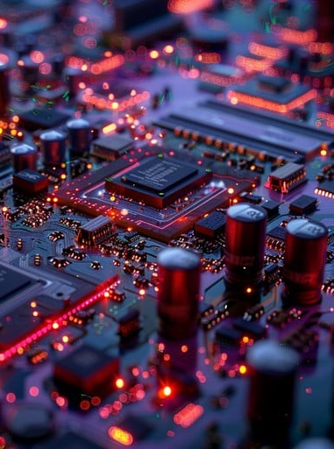
Thank You.

